Slide 1
Long Short-Term Memory
LSTM
Presented By
Anlin Albert
M20MCA026

Slide 2
Pre-requisites
Neural networks
Back propagation
Basics of RNN
Activation functions

Slide 3
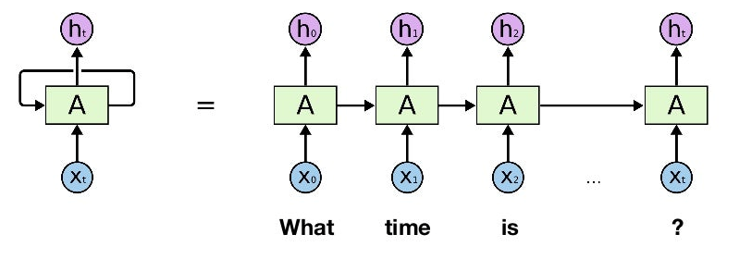
What is RNN?
A RNN (Recurrent Neural Network) can be seen as a layer in a neural network used for encoding sequential data into a vector representation that can then be used for various tasks such as classification or just as an encoding. In other words, it’s a method to perform feature engineering in an automated way for sequential data.

Slide 4
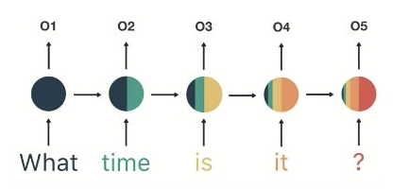
RNN Drawbacks
Long term dependencies are not captured, as the number of time steps increase - the RNN is unable to connect information.
Vanishing gradient problem causes loss of long term memory, while emphasising short term.
Exploding gradient.

Slide 5
How do LSTMs Work?
LSTMs try to add long term memory to remember certain hidden states more than the others. This allows them to retain knowledge over longer sequences.
They have two outputs instead of one, the hidden state and the cell state. Their computation is bit more complex than RNNs

Slide 6
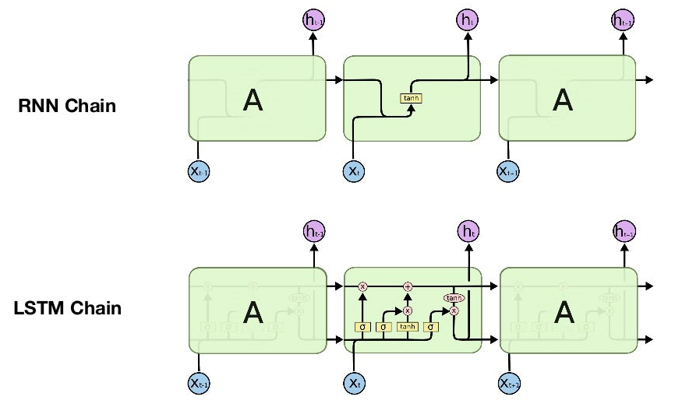

Slide 7
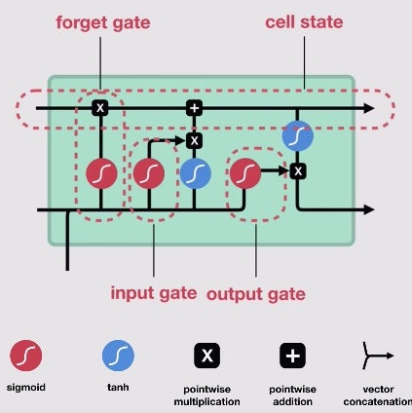
LSTM Architecture
LSTM consists of 3 gates - Forget gate, Input gate & output gate
Cell state is a channel that runs along the LSTM chain carrying information from one step to another

Slide 8



Slide 9
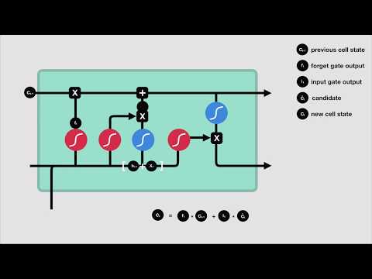

Slide 10
Some LSTM Applications
Language modeling
Image processing
Speech and handwriting recognition
Language translation

Slide 11
LSTM Drawbacks
High memory bandwidth
Sophisticated architecture
Unable to completely remove vanishing gradients

Slide 12
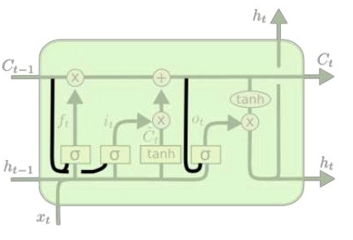
LSTM Variations - Peephole
One popular LSTM variant, introduced by Gers & Schmidhuber (2000), is adding “peephole connections.” This means that we let the gate layers look at the cell state.

Slide 13
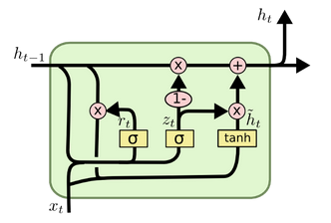
LSTM Variations - GRU
Another variation on the LSTM is the Gated Recurrent Unit, or GRU, introduced by Cho, et al. (2014). it combines the forget and input gate into update gate which is newly added in this architecture. It also merges the cell state and hidden state. The resulting model is simpler than traditional LSTM and it is growing more popularity.

Slide 14
LSTM Variations Comparison
They are all about the same in performance
We can reduce the number of parameters and the computational cost by: coupling the input and forget gates (GRU), removing peephole connections

Slide 15
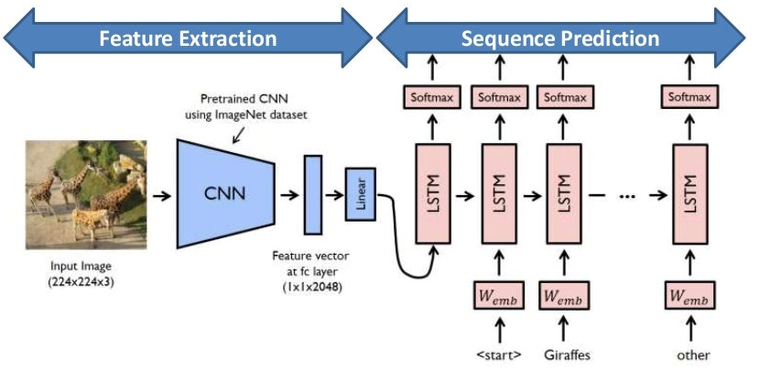
CNN - LSTM
It is an LSTM architecture specifically designed for sequence prediction problems with spatial inputs like images or videos.

Slide 16
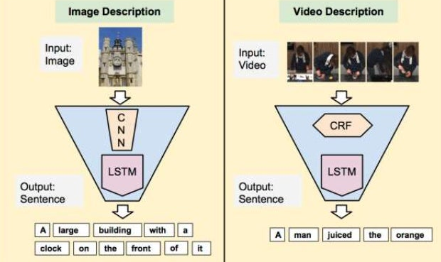
Using CNN - LSTM
Image description Video description

Slide 17
References
Abobakr, A., Hossny, M., Abdelkader, H., & Nahavandi, S. (2018). RGB-D Fall Detection via Deep Residual Convolutional LSTM Networks. 2018 Digital Image Computing: Techniques and Applications (DICTA).
Bulbul, E., Cetin, A., & Dogru, I. A. (2018). Human Activity Recognition Using Smartphones. 2018 2nd International Symposium on Multidisciplinary Studies and Innovative Technologies (ISMSIT).
Wang, H., Zhao, J., Li, J., Tian, L., Tu, P., Cao, T., … Li, S. (2020). Wearable Sensor-Based Human Activity Recognition Using Hybrid Deep Learning Techniques. Security and Communication Networks, 2020, 1–12.
Agarwal, P., & Alam, M. (2020). A Lightweight Deep Learning Model for Human Activity Recognition on Edge Devices. Procedia Computer Science, 167, 2364–2373.
Das, S., Partha, S. B., & Imtiaz Hasan, K. N. (2020). Sentence Generation using LSTM Based Deep Learning. 2020 IEEE Region 10 Symposium (TENSYMP).

Slide 18
References
6. Shojaei-Hashemi, A., Nasiopoulos, P., Little, J. J., & Pourazad, M. T. (2018). Video-based Human Fall Detection in Smart Homes Using Deep Learning. 2018 IEEE International Symposium on Circuits and Systems (ISCAS).
7. Alemayoh, T. T., Hoon Lee, J., & Okamoto, S. (2019). Deep Learning-Based Real-time Daily Human Activity Recognition and Its Implementation in a Smartphone. 2019 16th International Conference on Ubiquitous Robots (UR).
8. Ullah, M., Ullah, H., Khan, S. D., & Cheikh, F. A. (2019). Stacked Lstm Network for Human Activity Recognition Using Smartphone Data. 2019 8th European Workshop on Visual Information Processing (EUVIP)
9. Sun, B., Liu, M., Zheng, R., & Zhang, S. (2019). Attention-based LSTM Network for Wearable Human Activity Recognition. 2019 Chinese Control Conference (CCC).
10. Deep, S., & Zheng, X. (2019). Hybrid Model Featuring CNN and LSTM Architecture for Human Activity Recognition on Smartphone Sensor Data. 2019 20th International Conference on Parallel and Distributed Computing, Applications and Technologies (PDCAT)
11. Phi, Michael. “Illustrated Guide to LSTM’s and GRU’s: A step by step explanation”. Towards Data Science, 24 September 2018, https://towardsdatascience.com/illustrated-guide-to-lstms-and-gru-s-a-step-by-step-explanation-44e9eb85bf21.

Slide 19
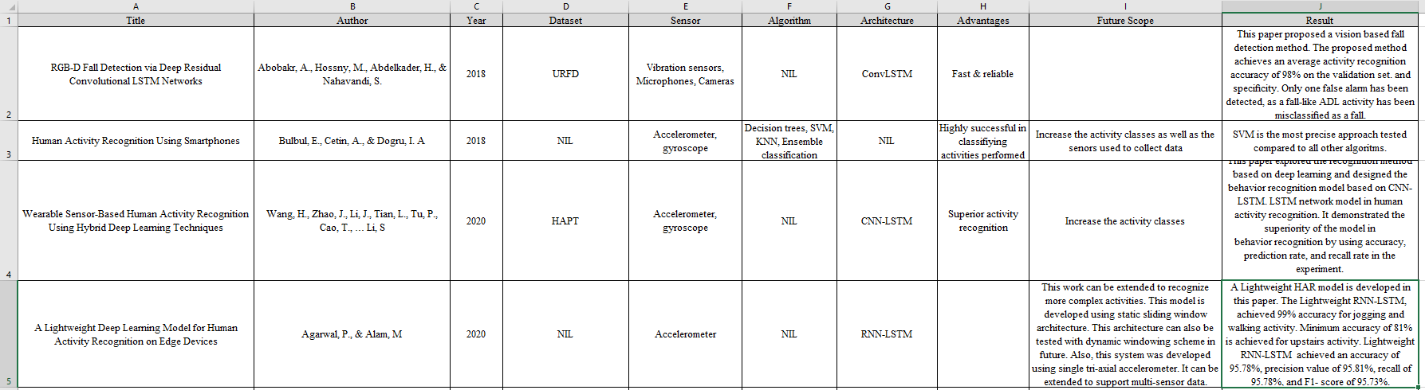

Slide 20
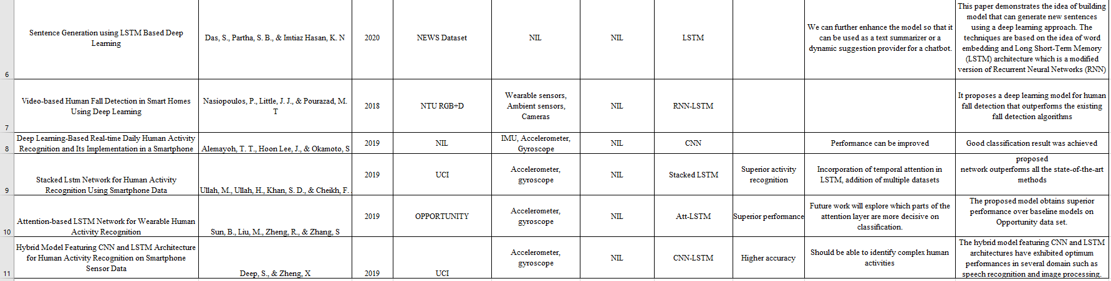

Slide 21
Conclusion
The study has shown that this recurrent system is capable of handling a wide range of issues, including sentiment analysis, computer vision, time series forecasting, text recognition, natural language processing, picture and video captioning, and text recognition. It was discovered that combining LSTM with other architectures achieves the best performance and is a typical strategy when modeling the majority of these issues.
Based on the study, the learning rate is the most significant hyperparameter in the backpropagation algorithm, while the forget gate and output transfer function are the most crucial parts of the LSTM block. Therefore, additional research into these elements may result in LSTM variants with enhanced prediction skills.

Slide 22
Thank You
Anlin Albert
M20CA026

